Slide 1
QUANTUM ION JUNCTION TRAP
Group Members: Robert Laskey, Ezra Manus, Calvin Mitchell, Andrew Wilken
Advisor: Durga Paudyal
Clients: Gavin Nop, Jonathan Smith

Slide 2
Context on Qubits and Coherence Time for Trapped-Ion Quantum Computing
Hyperfine qubits are used for TIQC
Hyperfine refers to when a single energy level is split into multiple smaller energy levels
Qubit states are defined by the lower energy state (|0>) and the higher energy state(|1>)
These qubits are highly susceptible to environmental perturbations and must be adequately isolated
Coherence time is a term used to express how long a qubit can maintain its state without losing its superposition (collapsing to initial state) due to environmental perturbations
Extremely accurate lasers are used to perform splitting, state initialization, cooling, and gate operations
Need: Isolated qubit resistant to environmental effects while able to be manipulated by lasers

Slide 3
Solution: Multi-level Ion trap device using a rare-earth qubit
Rare-earth qubit (Erbium): Due to the band structure and unique energy band characteristics of Erbium, hyperfine splitting of specific energy levels allows surrounding energy levels to act as natural barriers to environmental perturbations such as changes in EM fields or light contamination
Implanting the ion within a crystal works but subjects the ion to crystal effects
Using intentional electric fields and finely tuned lasers, ions can be levitated and moved, allowing for extremely precise operations including cooling, entanglement, and gate operations
Expand upon the concept of a linear trap to create a dual trap

Slide 4
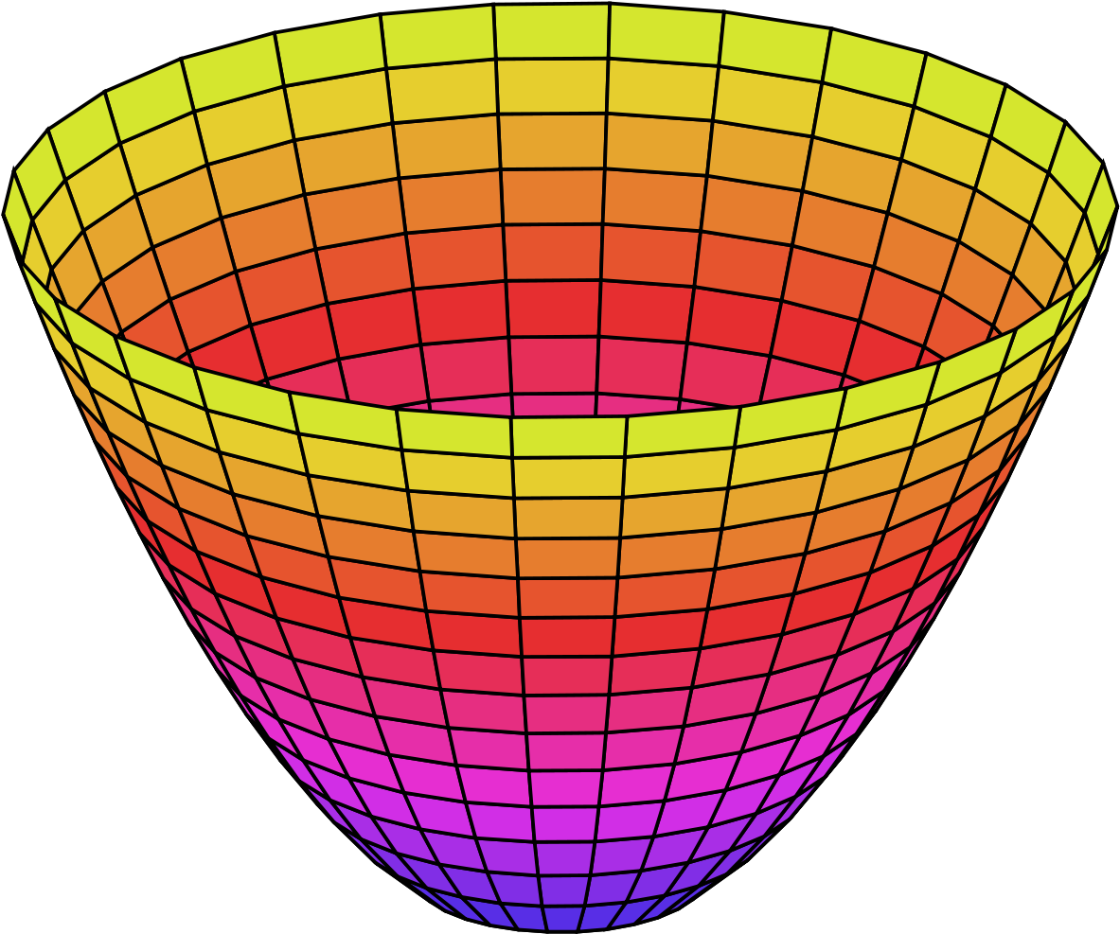
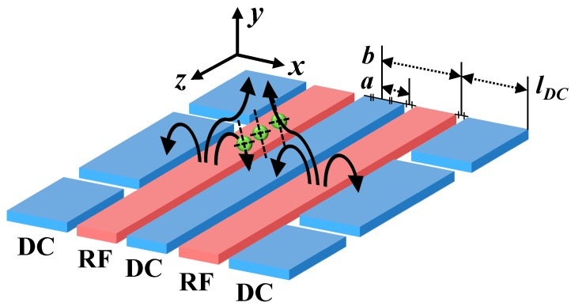
Electromagnetic Field Theory (single level)

Slide 5
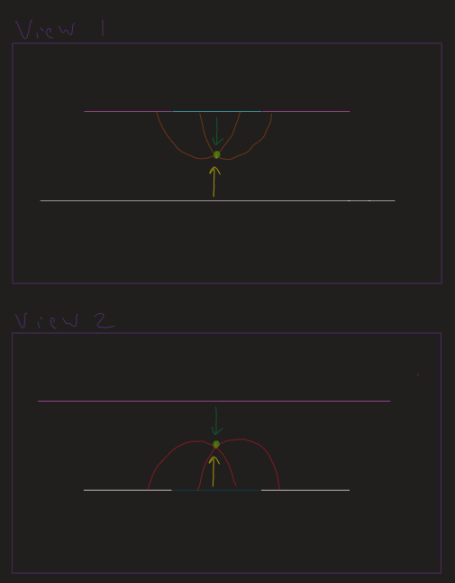
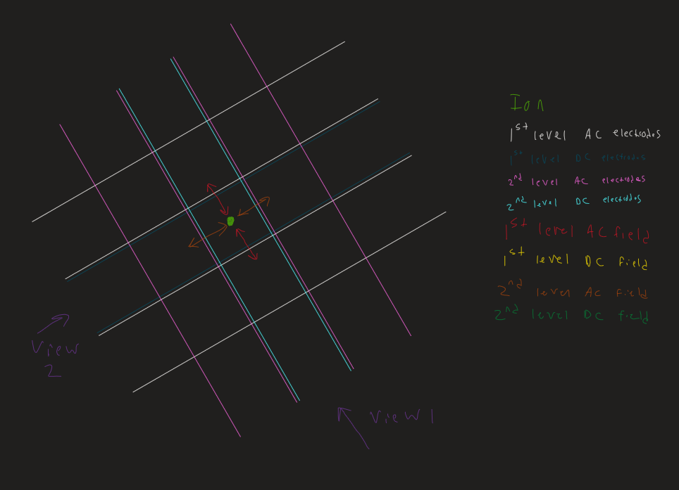
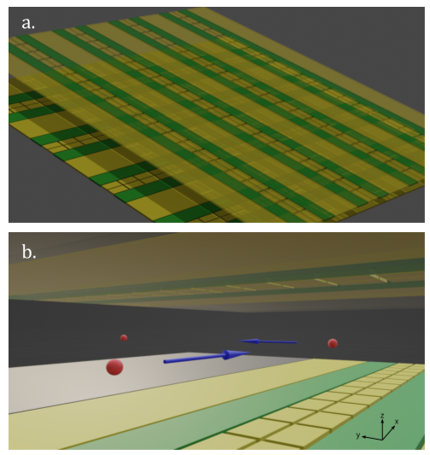
Electromagnetic Field Theory (Dual level)
Our ultimate goal: Create a large-scale model of this dual level trap design using human-manipulable materials

Slide 6
Our Goal
Our advisor and client described the goal of this project to build a dual-trap that is capable of inducing oscillating movement for a charged particle
Going into testing, we decided on using styrofoam as our “charged particle”

Slide 7
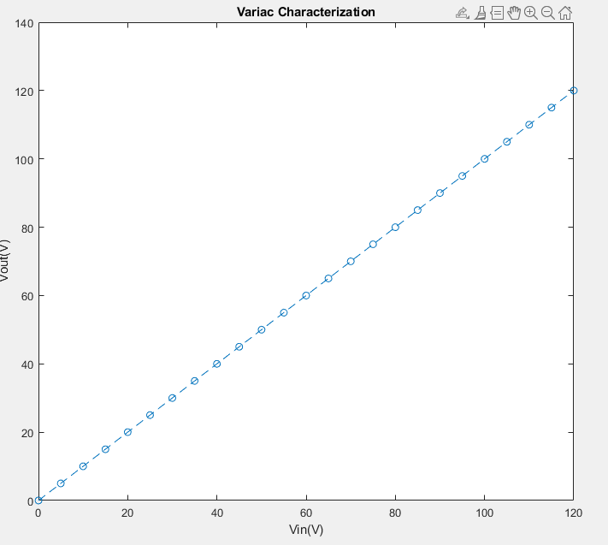
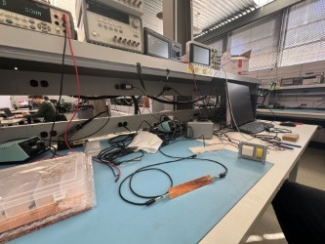
Variac Testing
To test the Variac, we had to ensure that the output was constant and matched the voltage set

Slide 8
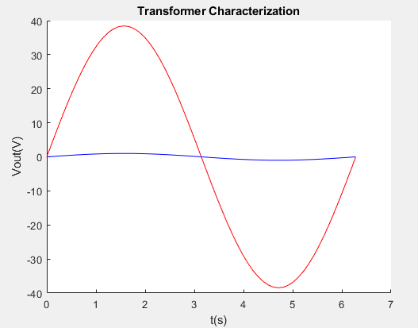
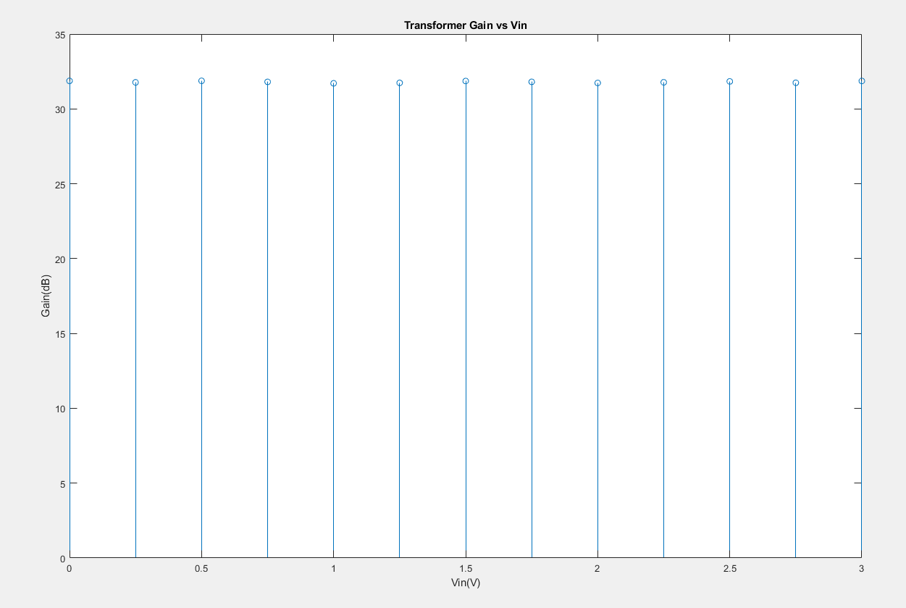
Transformer Testing
To test the Transformer, we input AC waves at 60hz with a variety of voltages a a sufficiently high loading

Slide 9
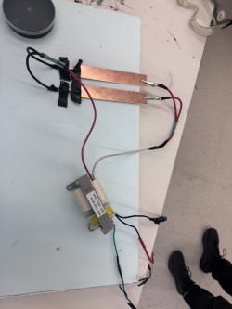
Iteration 1 - Styrofoam Particles
Observations: Particles were observed vibrating at 6hz, +/- 4hz.
Voltage was tested from 1600 to 3500V
Movement started at ~2880V, and maxed out at about 3400 V
Setup:

Slide 10
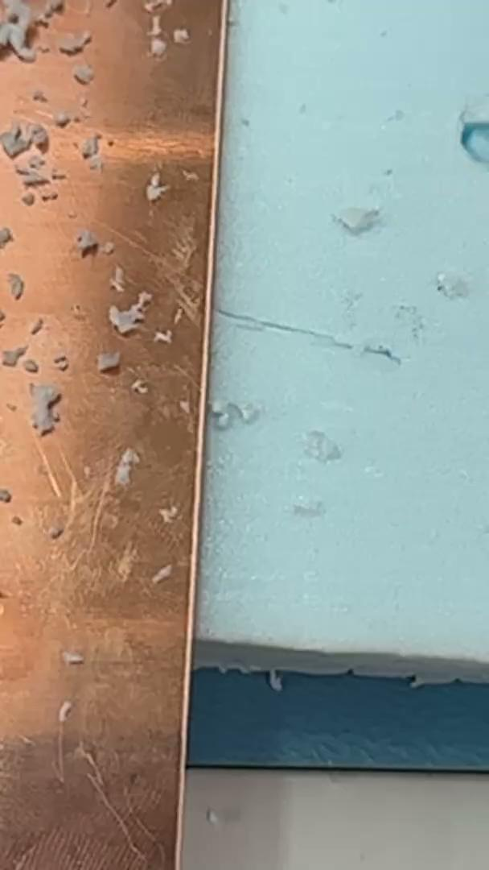
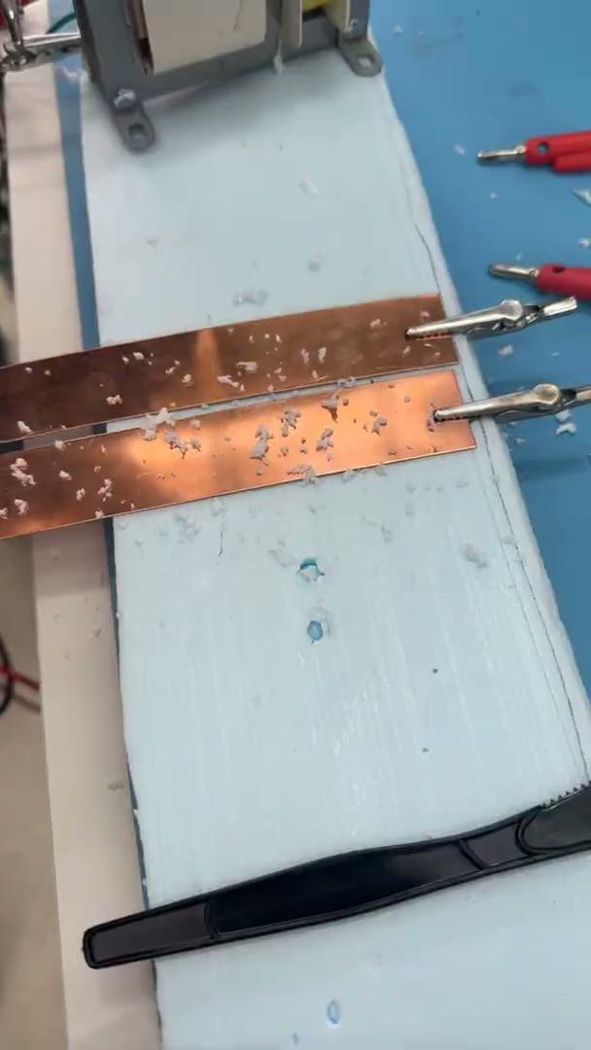
Particle Movement
Here, we see a video of particle movement, as it oscillates back and forth, at an ideal frequency range

Slide 11
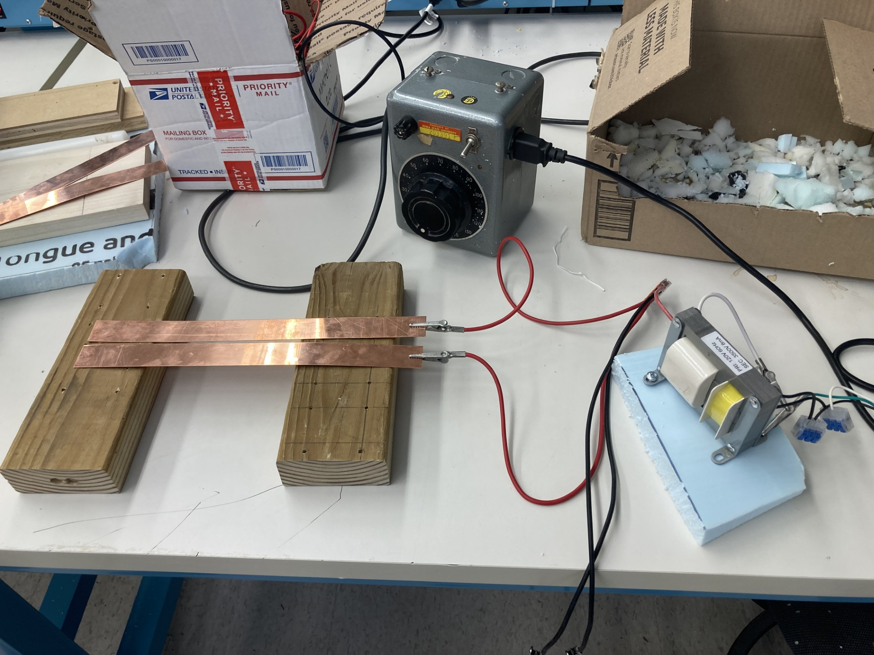
Iteration 2 - Wooden Base
Motivations: It was possible particles were attracted to the foam base.
Observations: Particles Movement increased slightly
Setup:

Slide 12
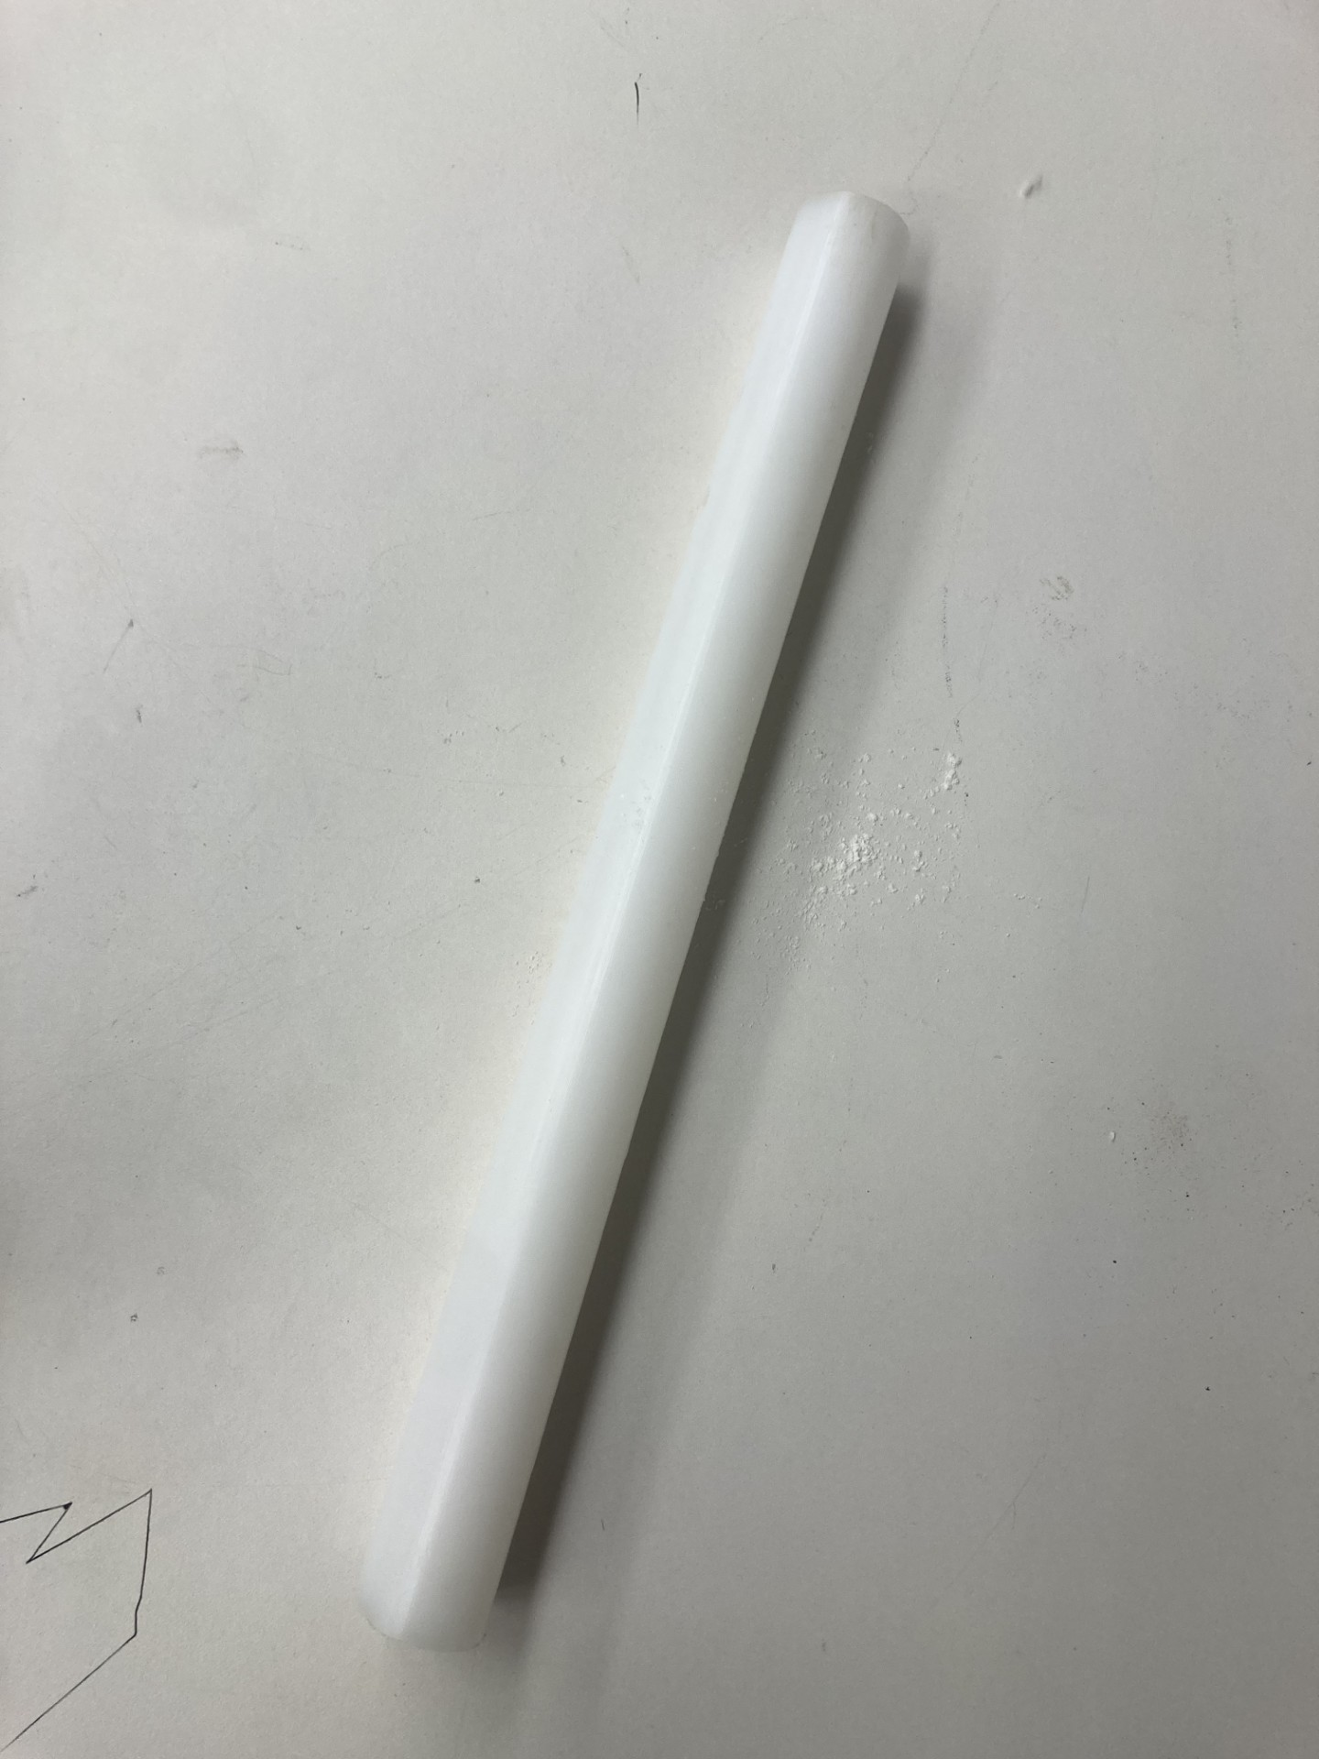
Iteration 3 - Teflon Rod
Motivations: To increase charge density, a teflon rod is an ideal method to reach high static charges
Observations: There was a marked increase in the static charge of particles - unclear if movement increased due to the change
Change:

Slide 13
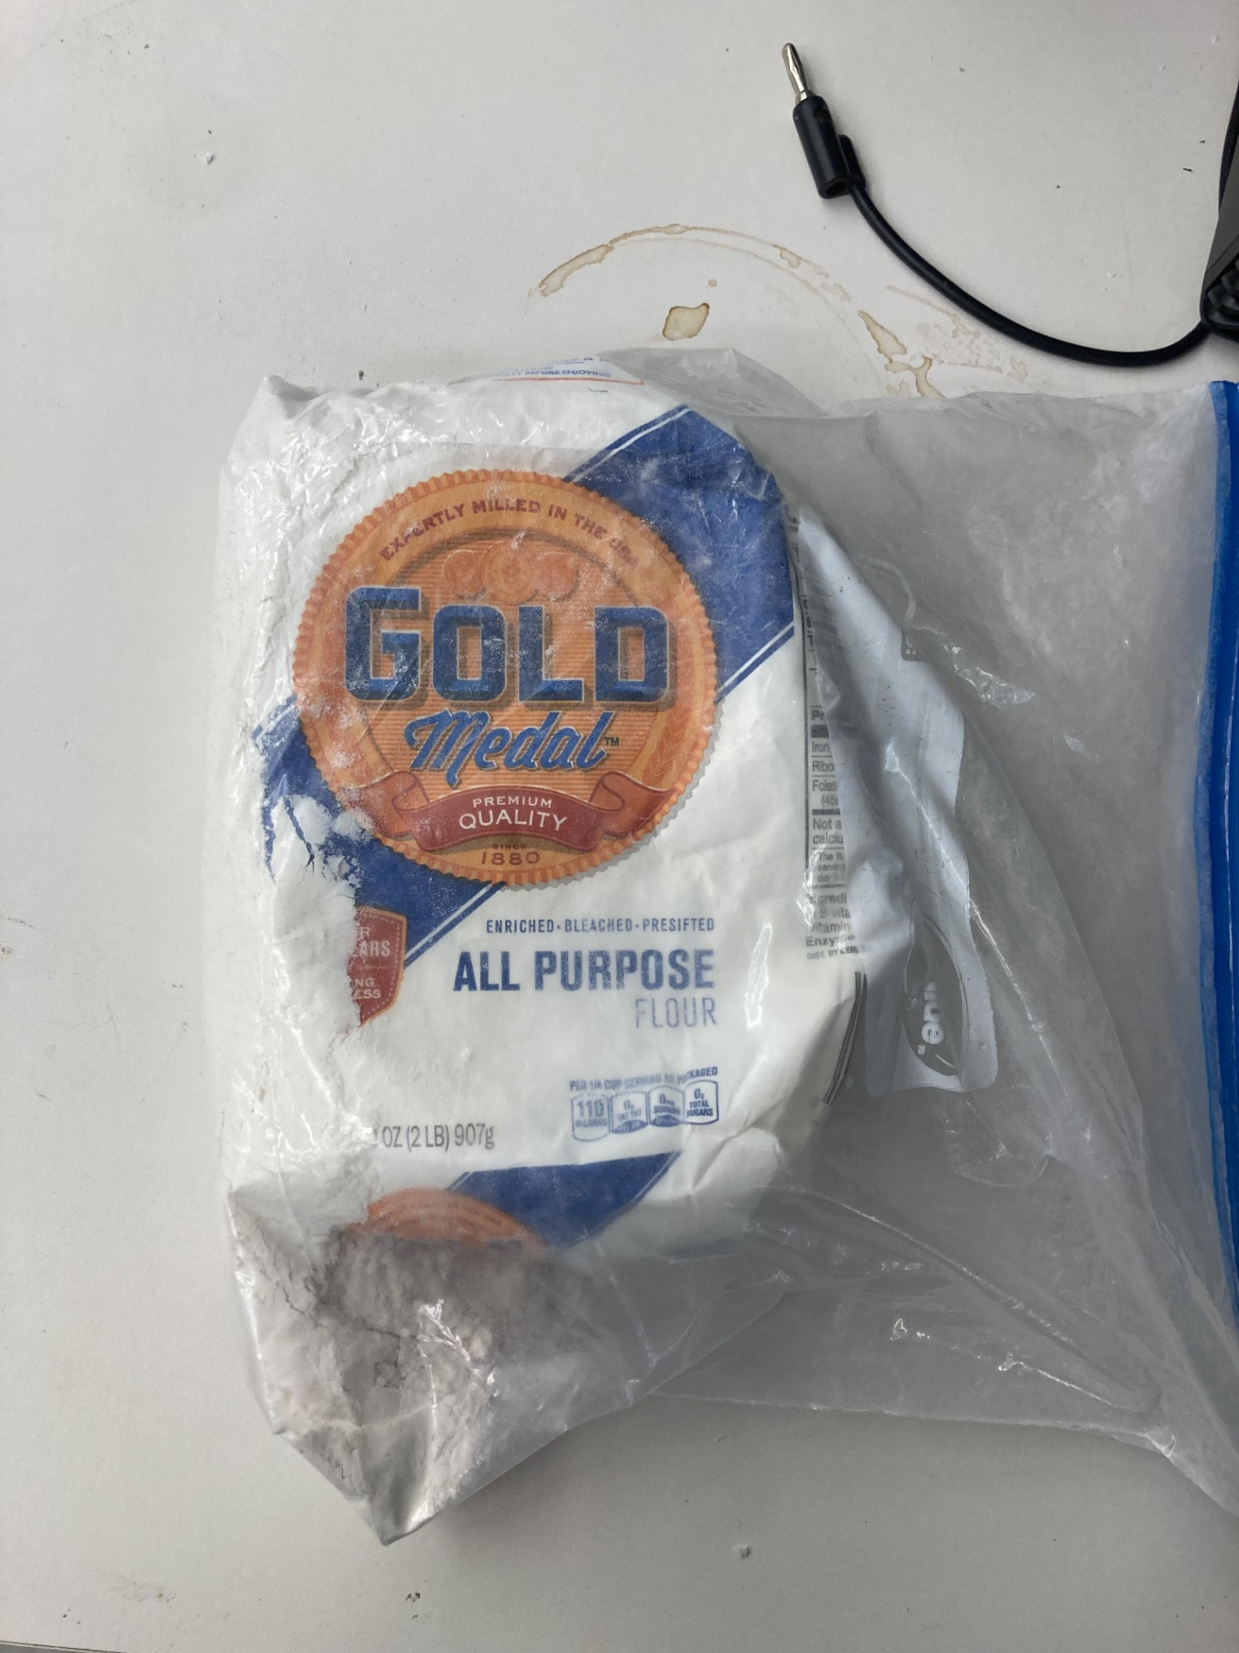
Iteration 4 - Flour
Motivations: It was possible the styrofoam pieces were too large to hold in the saddle point. Flour is reasonably chargeable and much smaller
Observations: There was a marked increase in the static charge of particles - unclear if movement increased due to the change
Change:

Slide 14
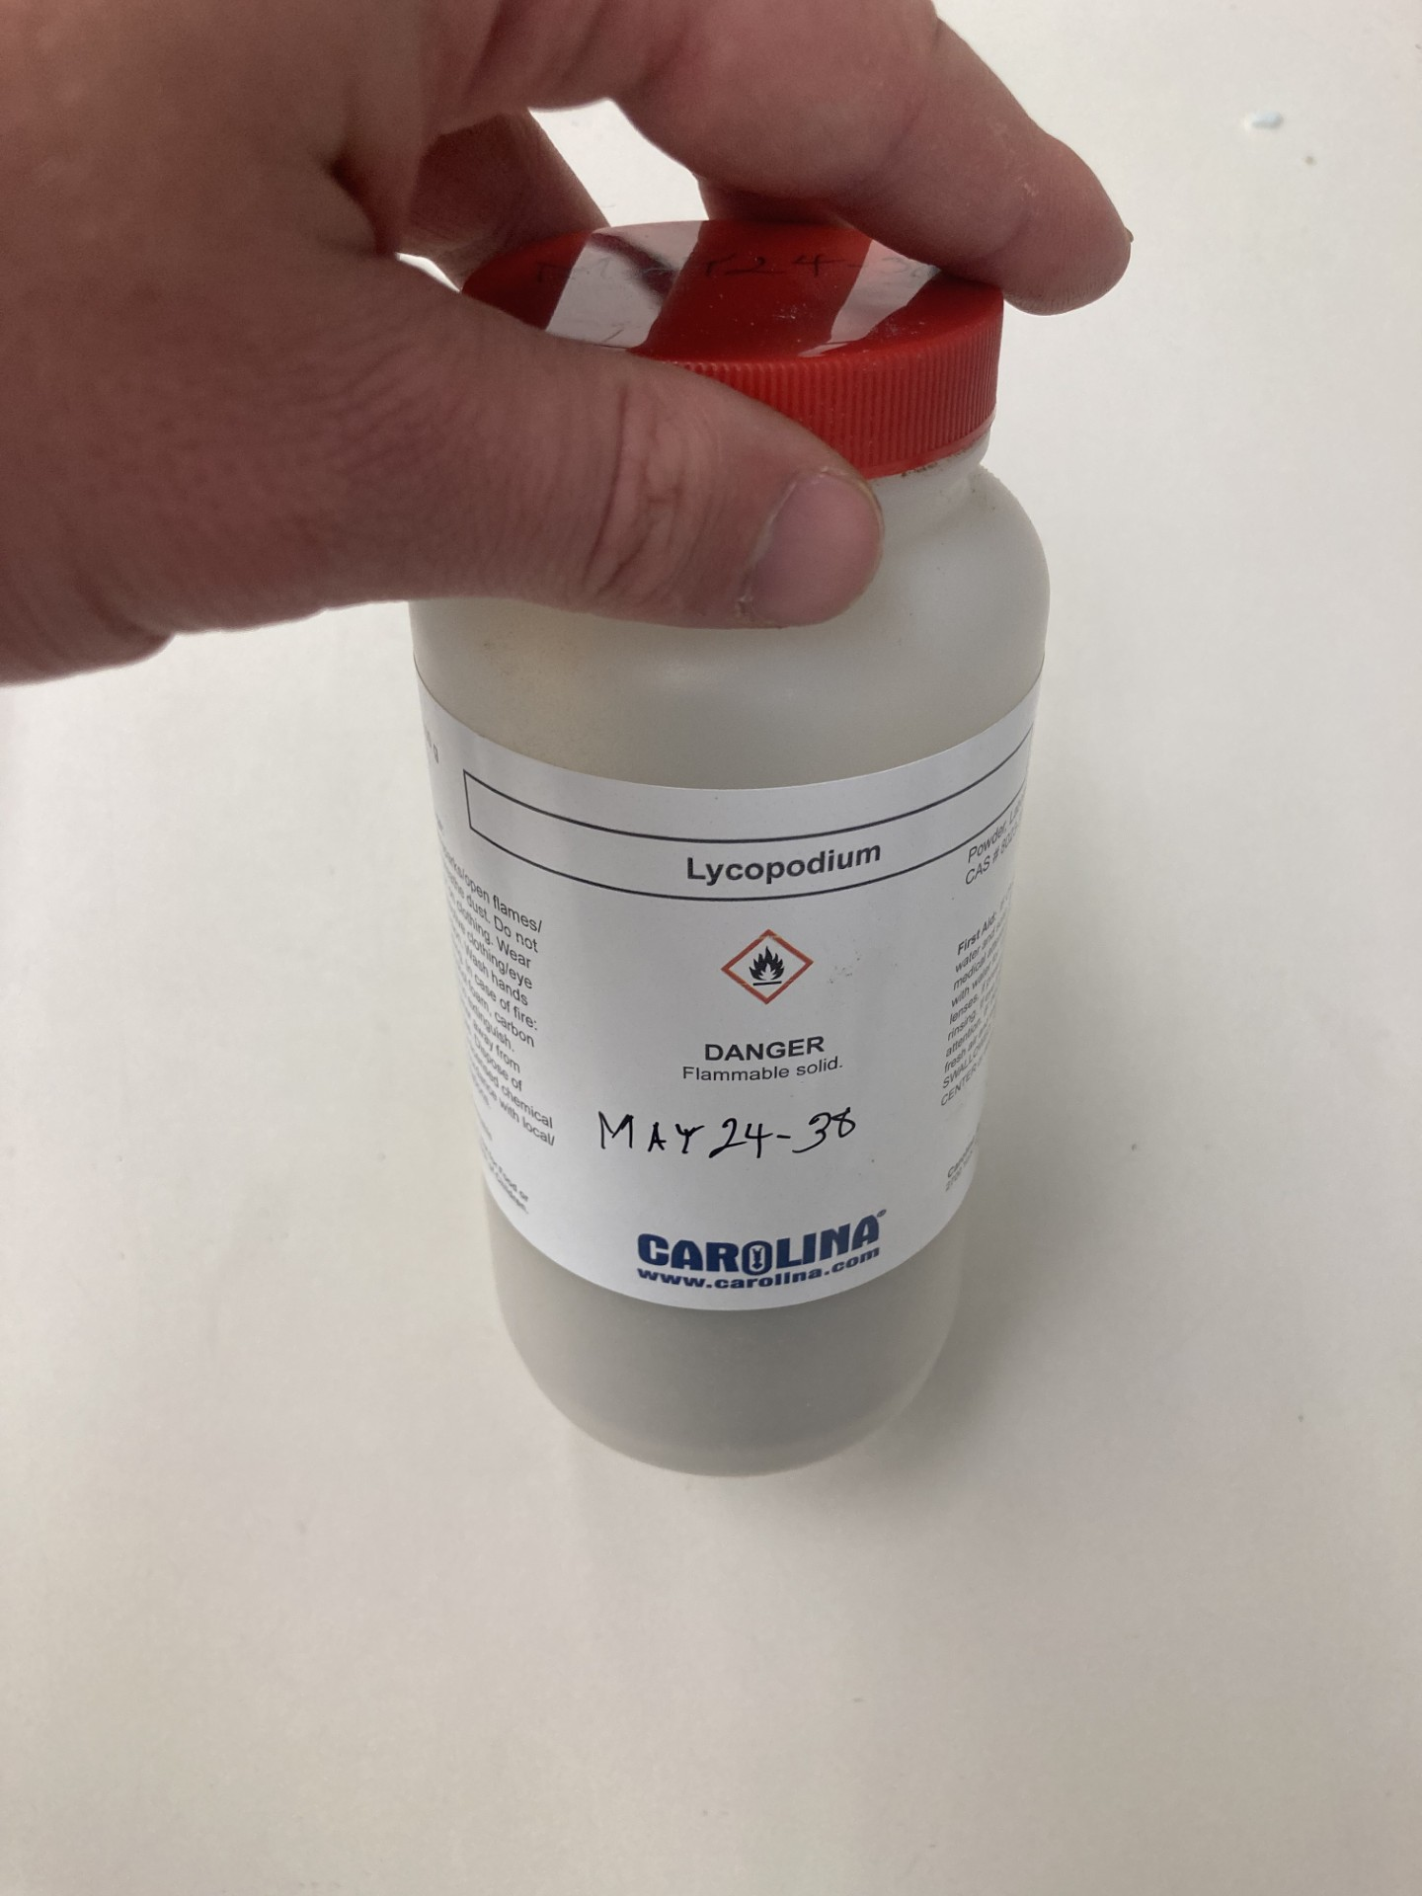
Iteration 5 - Lycopodium Powder
Motivations: Lycopodium powder has an exceptionally high charge/mass ratio
Observations: There was not a visible difference in charge with flour
Change:

Slide 15
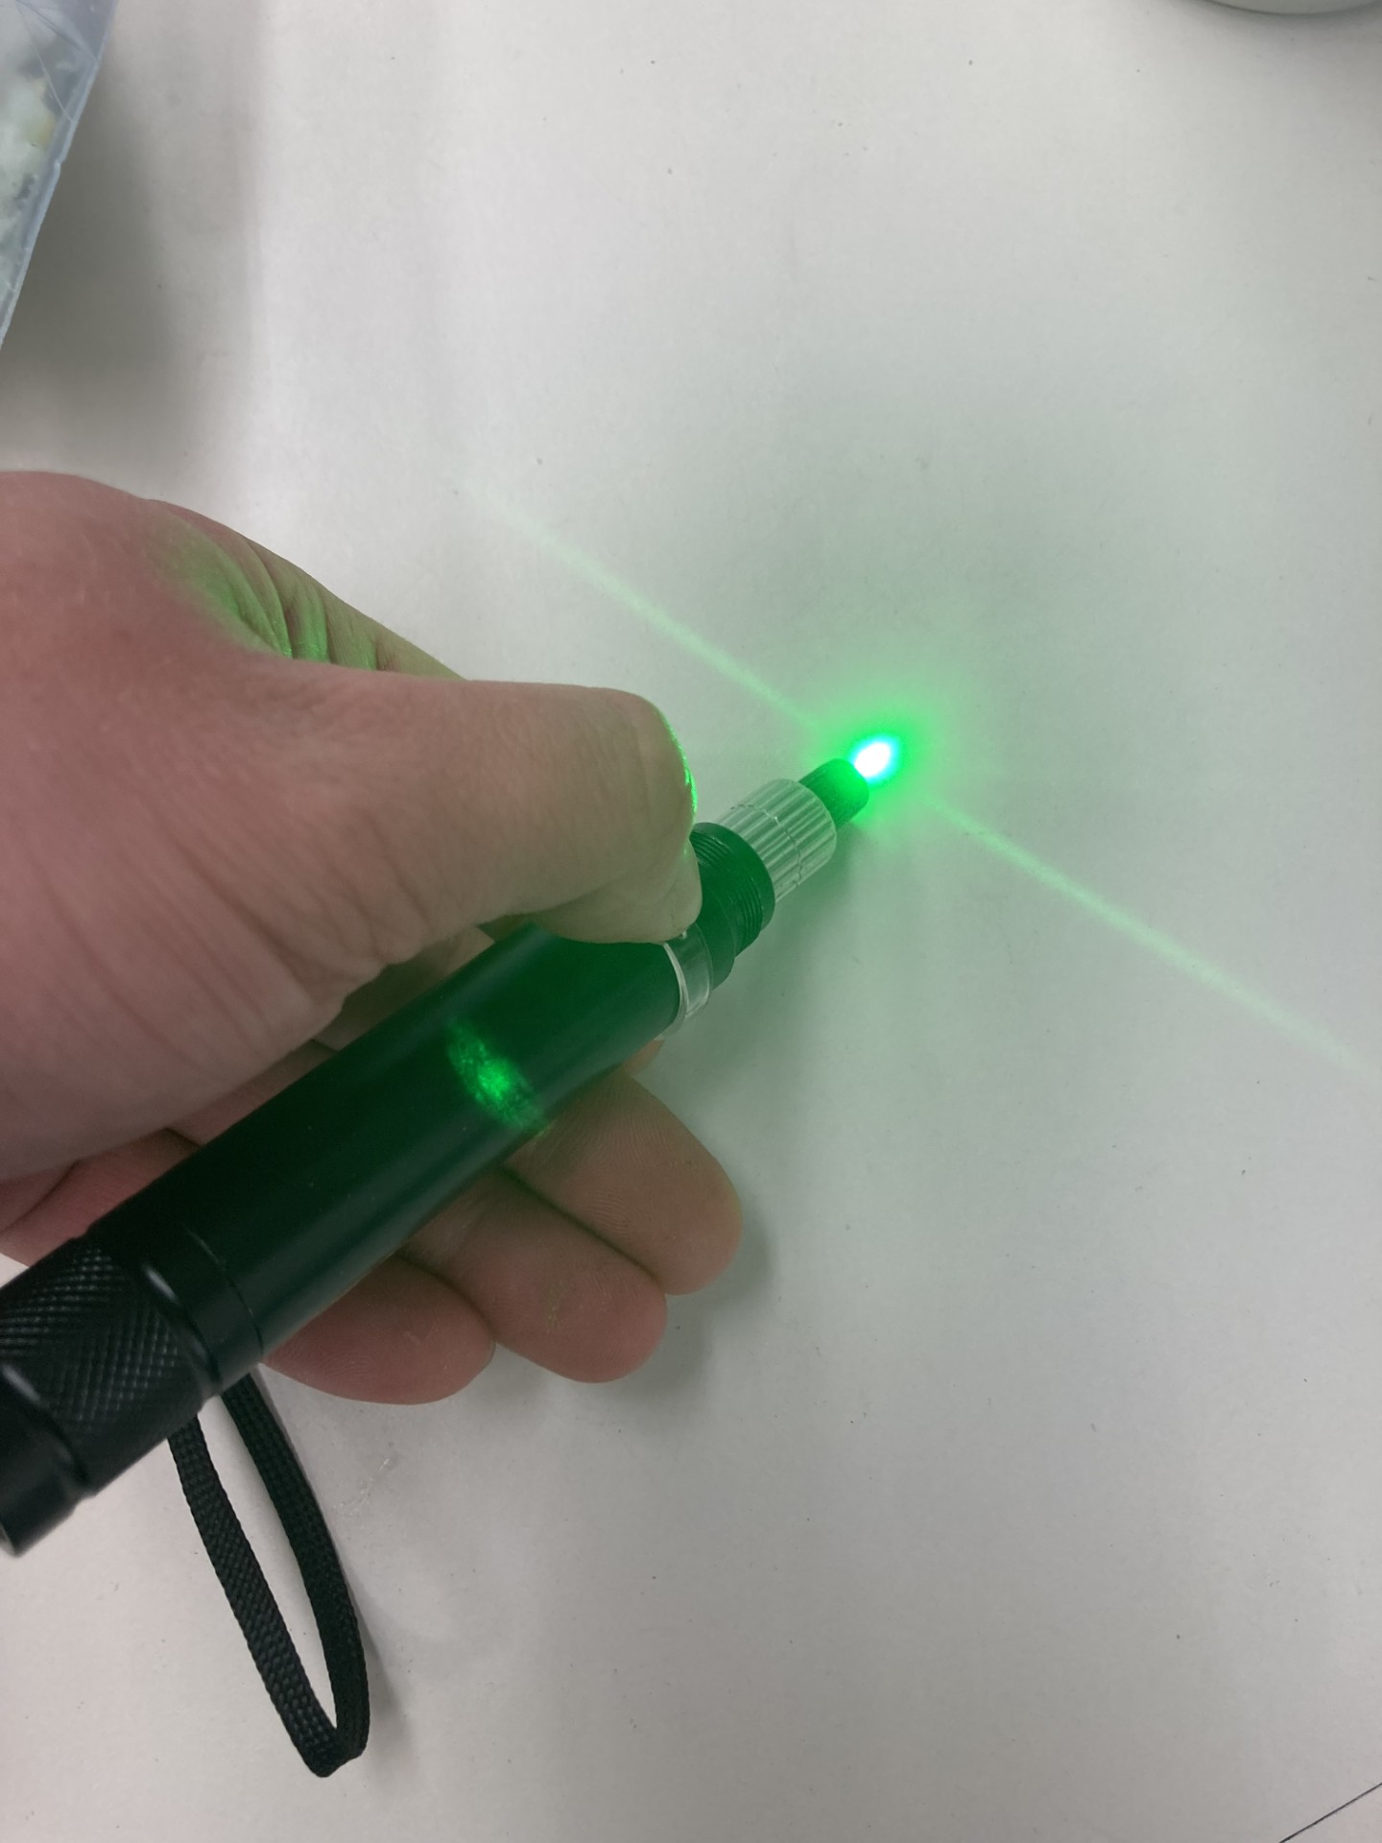
Iteration 6 - Laser Illumination
Motivations: It was possible that particles were being trapped, but too small to see
Observations: It was significantly easier to view particles
Change:

Slide 16
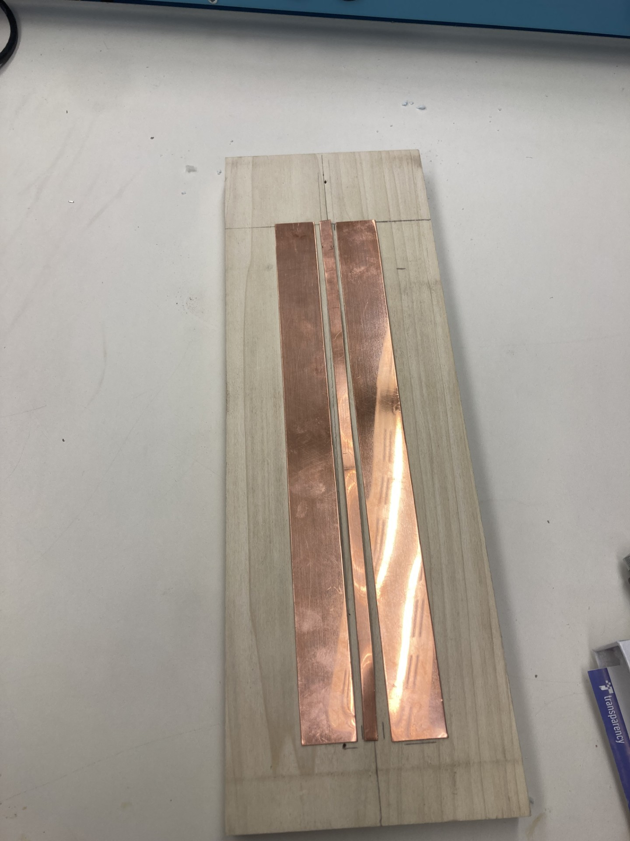
Iteration 7 - DC Electrode
Motivations: It is not theoretically necessary, but a DC Electrode can help keep particles suspended vertically.
Observations: Testing was unable to be performed - during the safety check, we were unable to avoid arcing
Note: Arcing is attributed to being unable to get a clean cut on a piece that thin
Change:
Notes:
help fight the effects of gravity

Slide 17
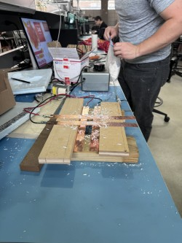
Iteration 8 - Perpendicular Trap
Motivations: It is possible that the novel designs trapping force would be more significant, trapping
Observations: No marked Changes
Change:

Slide 18
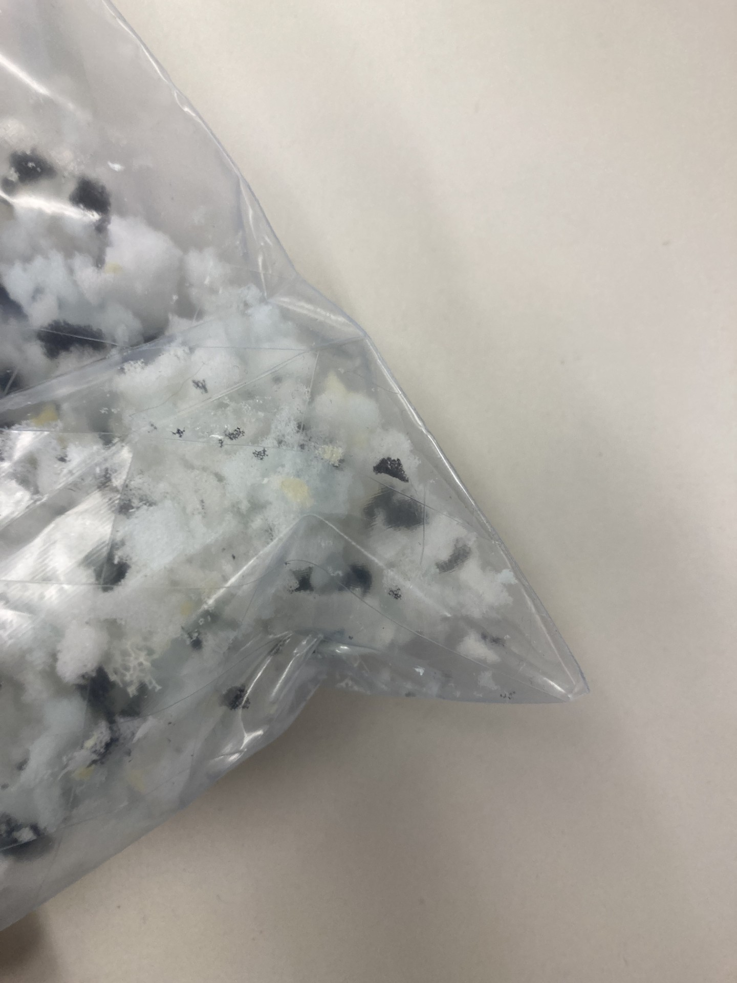
Iteration 9 - Memory Foam
Motivations: A Group member noticed at home that they were incredibly statically charged, and collected some for testing
Observations: The particles were very charged, and movement observed was roughly the same as styrofoam
Change:

Slide 19
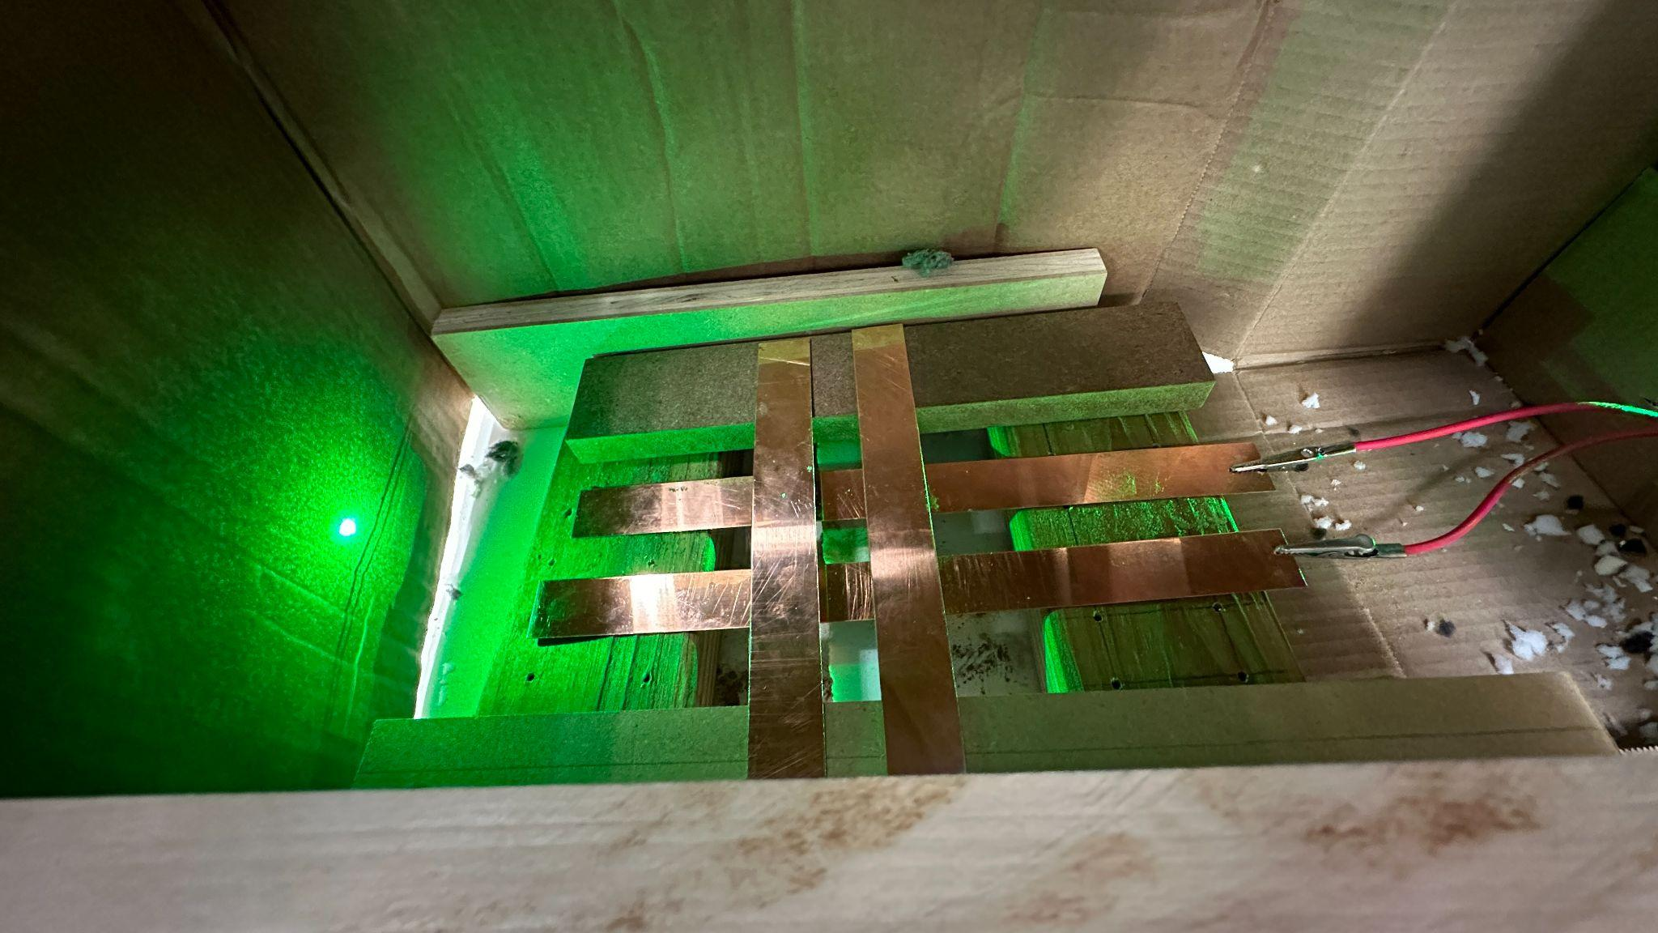
Final Iteration - Enclosure
Motivations: It was possible that the outside environment was causing too much influence, and the old cover was not large enough for the perpendicular trap
Observations: Particles were observed along laser path - odd behavior was observed but no particles were trapped
Setup:

Slide 20
Possible Error Sources
Transformer Voltage: It is possible that the transformer was unable to output a Voltage high enough, as it was capped at 3.5kV
Environmental: It was impossible to control the movement of air, which could have led to pushing particles out of the saddle point, and the humidity, which could significantly affect the static charge on the particles
Frequency: it is possible smaller particles were vibrating too fast to be trapped by a 60hz signal - they were recorded at 6hz, but there is a very remote possibility aliasing caused an improper frequency to be measured.

Slide 21
Conclusion
We succeeded at our main goal of causing oscillatory movement of particles with our trap
Unfortunately, we were unable to visibly see any lycopodium powder trapped with the use of laser light.
We would like to highlight that our advisor and clients would like to file a patent for our design prototype capable of inducing oscillating movement.

